Slide 1

5G Physical Layer Security
5G Network Security Landscape
Video 4.4

Slide 2
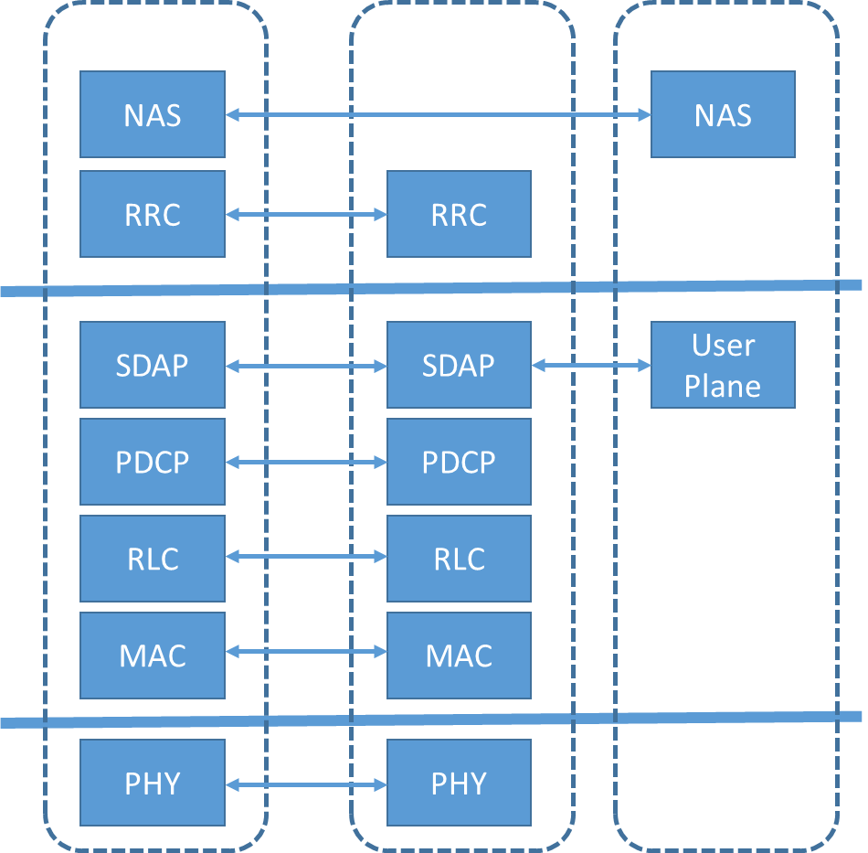
Air Interface
Open Systems
Interconnection Layer
Layer 3
Network
NAS: Non-Access Stratum
RRC: Radio Resource Control
SDAP: Service Data Adaptation Protocol
PDCP: Packet Data Convergence Protocol
RLC: Radio Link Control
MAC: Medium Access Control
PHY: Physical
Layer 2
Data
Layer 1
Physical
Physical Layer Security (PLS)

Slide 3
PLS Concept
Main Channel
Bob
Legitimate Receiver
Wiretap Channel
Alice
Eve
Transmitter
Eavesdropper

Slide 4
PLS Approaches
Cryptography
Process of changing data into unreadable form so that only authorized systems or applications can decode it
Information-Theoretic Security
Key-free encryption using wireless channel characteristics and metrics

Slide 5
PLS Techniques
Secrecy rate
Quality of Service (QoS) metrics, including Signal-to-Interference-plus-Noise Ratio (SINR) and Bit Error Rate (BER)
Channel State Information (CSI)
Multiple-Input-Multiple-Output communication
Beamforming

Slide 6
Key Takeaways
01
Physical Layer Security is Important
5G security starts at Layer 1.
02
Two Approaches
Cryptography and information-theoretic security.
03
Multiple Techniques
Using information-theoretic security metrics.

Slide 7
5G-WLAN Security
Next Video

